Slide 1
Relational Database Implementation and Applications
Date of Presentation: 8/20/2023

Slide 2
Lesson 2:
Advanced Window Functions and OLAP Queries
Gerald Balekaki

Slide 3
Outline
Advanced SQL window functions
Ranking: Rank, dense_rank, percent_rank, cume_dist, row_number, ntile(n)
Windowing: Moving averages and running sums/totals
OLAP Queries in SQL
Group by
Rollup and Cube functions
Activities:
Practice: Part 1 and Part 2
Assessment: 3rd deliverable

Slide 4
Ranking
RANKING is done together with an ORDER BY specification
Example:
Employee (row_num, first_name, last_name, salary)
To find the rank of each employee in respect to their salary.
SELECT row_num, first_name, last_name,
RANK() OVER (ORDER BY salary DESC) as s_rank
FROM Employee
ORDER BY s_rank;
- - 2nd ORDER BY is needed to get the ranks in order
NB:
RANK() -- ranking may leave gaps: e.g., if 2 employees have the same top salary, both have rank 1, and the next rank is 3
DENSE_RANK() does not leave gaps, so next dense rank would be 2

Slide 5
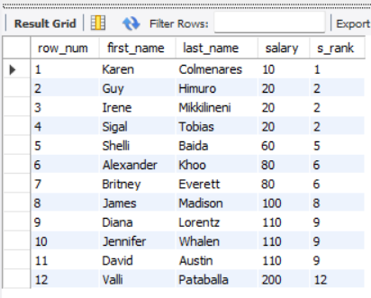
Ranking – RANK()
Usage of rank():
SELECT row_num, first_name, last_name,
RANK() OVER (ORDR BY salary ASC) as s_rank
FROM Employee
Ranking can be done using basic SQL aggregation, but resultant query is very inefficient
SELECT first_name, (1 + (select count(*) FROM employee B WHERE B.salary > A.salary)) as s_rank FROM employee A ORDER BY s_rank;

Slide 6
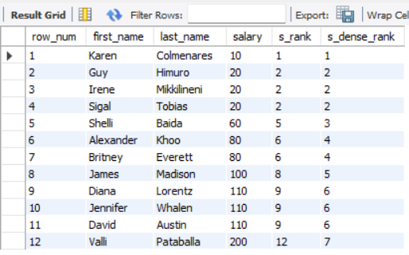
Ranking – DENSE_RANK()
Usage of Dense_rank():
SELECT row_num, first_name, last_name, DENSE_RANK() OVER (ORDER BY salary ASC) as s_dense_rank
FROM Employee
Multiple rank clauses can occur in a single SELECT clause
SELECT row_num, first_name, last_name,
RANK() OVER (ORDER BY salary ASC) as s_rank,
DENSE_RANK() OVER (OREDR BY salary ASC) as s_dense_rank
FROM Employee

Slide 7
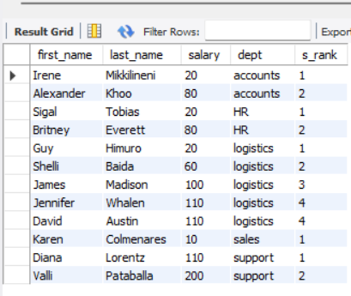
Ranking – cont’d..
Ranking can be done within a partition of data specified
Find the salary rank of each employee within each department (highest paid per dept)
SELECT first_name, last_name, salary, dept, RANK() OVER (PARTITION BY dept ORDER BY salary) as s_rank
FROM Employee;

Slide 8
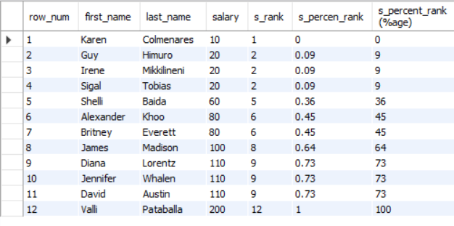
Ranking – Percent_Rank()
PERCENT_RANK() -- calculates the percentile rank of a row within a partition or result set.
Formula : (rank - 1) / (total_rows - 1)
It returns a number that ranges from 0 to 1.
percent_rank (can be done within partition, if necessary)
SELECT row_num, first_name, last_name, salary, RANK() OVER (ORDER BY salary) as s_rank,
ROUND (PERCENT_RANK() OVER (ORDER BY salary), 2) as s_percen_rank,
ROUND (PERCENT_RANK() OVER (ORDER BY salary), 2)*100 as 's_percent_rank (%age)’
FROM Employee;

Slide 9
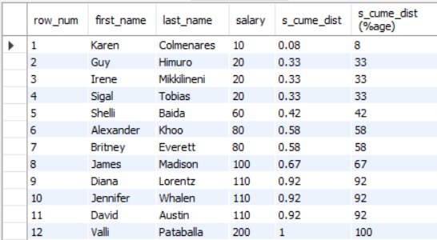
Ranking – CUME_DIST()
CUME_DIST() -- represents the number of rows with values less than or equal to that row’s value divided by the total number of row
Formula : (ROW _NUMBER / (total_rows)
It returns a value greater 0 and less than 1
(0 < VALUE <=1).
cume_dist (fraction of tuples with preceding values)
SELECT row_num, first_name, last_name, salary, ROUND(CUME_DIST() OVER (ORDER BY salary), 2) as 's_cume_dist’,
ROUND(ROUND(CUME_DIST() OVER (ORDER BY salary), 2)*100,2) as 's_cume_dist (%age)’
FROM Employee;

Slide 10
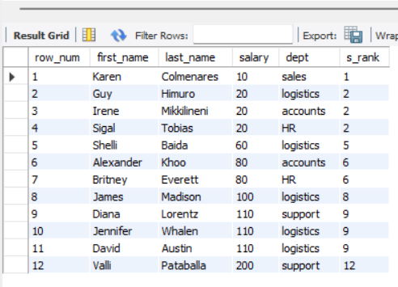
Ranking – ROW_NUMBER()
ROW_NUMBER() -- assigns a sequential number to each row in the result set.
The first number begins with 1.
row_number (non-deterministic in presence of duplicates)
SELECT ROW_NUMBER() OVER (ORDER BY salary) as row_num,
first_name, last_name, salary, dept, RANK() OVER (ORDER BY salary) as s_rank
FROM Employee;

Slide 11
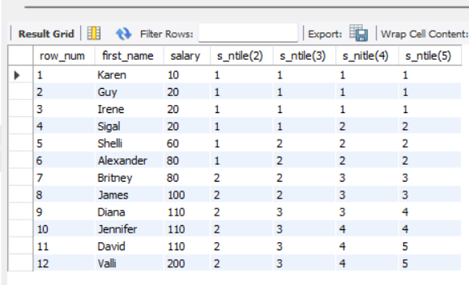
Ranking – NTILE(n)
For a given constant n, the ranking function NTILE(n) takes the tuples in each partition in the specified order.
It divides them into n buckets with equal numbers of tuples.
It returns a bucket number representing the group to which the row belongs.
SELECT row_num, first_name, salary,
NTILE(2) OVER (ORDER BY salary) as 's_ntile(2)’,
NTILE(3) OVER (ORDER BY salary) as 's_ntile(3)’,
NTILE(4) OVER (ORDER BY salary) as 's_nitle(4)’,
NTILE(5) OVER (ORDER BY salary) as 's_ntile(5)’
FROM Employee;

Slide 12
Windowing – Frame Specifications
Windowing is used to smooth out random variations such as, moving averages, running totals over a window specifications
Window specifications:
frame_extent:
{frame_start | frame_between}
frame_between:
BETWEEN frame_start AND frame_end
frame_start, frame_end:
{ CURRENT ROW |
UNBOUNDED PRECEDING |
UNBOUNDED FOLLOWING |
expr PRECEDING |
expr FOLLOWING }
Examples:
between rows unbounded preceding and current
rows unbounded preceding
range between 10 preceding and current row
All rows with values between current row value –10 (previous 10 values) to current value
range interval 10 day preceding
Not including current row
Note:
If you specify the start only, then the end is the current row.

Slide 13
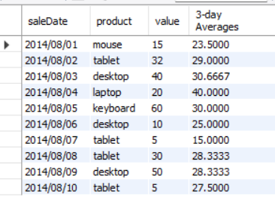
Windowing – Moving Average
Example: Moving average
Given product sales values for each date, calculate the average sales of products for each previous day, on that day and the next day.
SELECT saleDate, product, value, AVG(value)
OVER (ORDER BY saleDate ROWS BETWEEN 1 PRECEDING AND 1 FOLLOWING) as '3-day Averages’
FROM salesProduct;

Slide 14
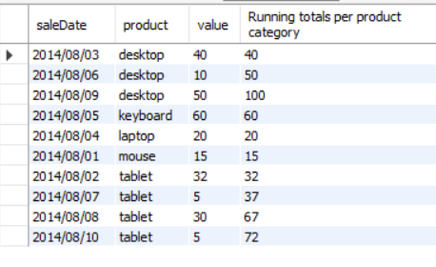
Windowing – Moving totals
Example: Moving/running Totals
Find running totals per product category. (frame_start : unbounded and
Frame_end: current row)
SELECT saleDate, product, value, SUM(value)
OVER (PARTITION BY product ORDER BY saleDate ROWS UNBOUNDED PRECEDING) as 'Running totals per product category’
FROM salesProduct;

Slide 15
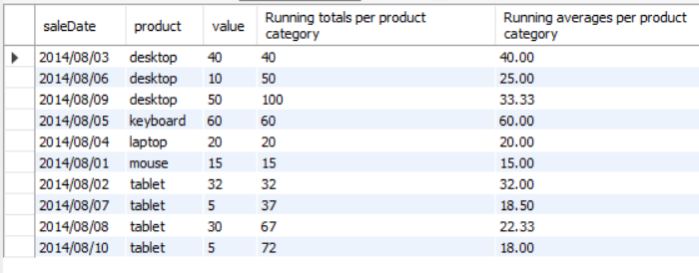
.. More examples
Find running totals and running averages for each product category.
frame_start : unbounded and frame_end: current
SELECT saleDate, product, value, SUM(value)
OVER (PARTITION BY product ROWS UNBOUNDED PRECEDING) as 'Running totals per product category’,
ROUND (AVG(value) OVER (PARTITION BY product ROWS UNBOUNDED PRECEDING),2) as 'Running averages per product category’
FROM salesProduct;

Slide 16
OLAP

Slide 17
Definition: OLAP
OLAP (Online Analytical Processing) is processing that allows users to interact (in an online fashion), analyze and explore multidimensional data to gain insights.
OLAP: Online Analytical Processing
For decision support
Historical data
Focus on summaries of records
OLTP: Online Transaction Processing
For day-to-day basis
Current data
Focus on individual records

Slide 18
Definition: OLAP …cont’d
Multidimension data is modeled as dimension attributed and measured attributes.
Measure attribute
Measures some value
Must be aggregated upon (e.g., attribute sales_value in sales table)
Dimension attribute
Defines the dimension on which measure attributes are viewed
E.g., propertyType, yearMonth, city

Slide 19
OLAP: taking GROUP By to a next level!
Aggregate SQL function without GROUP BY
SELECT SUM(value)
FROM Sales
WHERE date = ‘1-Jan’;
date | product | value
1-Jan | p1 | 10
1-Jan | p2 | 5
1-Jan | p1 | 10
1-Jan | p2 | 20
2-Jan | p1 | 5
2-Jan | p1 | 15
Sum(value)
= 45

Slide 20
OLAP: taking GROUP By to a next level!
Aggregate SQL function with GROUP BY (assume table: Sales)
SELECT date, product, SUM(value)
FROM Sales
GROUP BY date, product
date | product | value
1-Jan | p1 | 10
1-Jan | p2 | 5
1-Jan | p1 | 8
1-Jan | p2 | 20
2-Jan | p1 | 5
2-Jan | p1 | 15
date | product | value
1-Jan | p1 | 18
1-Jan | p2 | 25
2-Jan | p1 | 20
Drill down (see breakdown)
Rollup (see summarized)

Slide 21
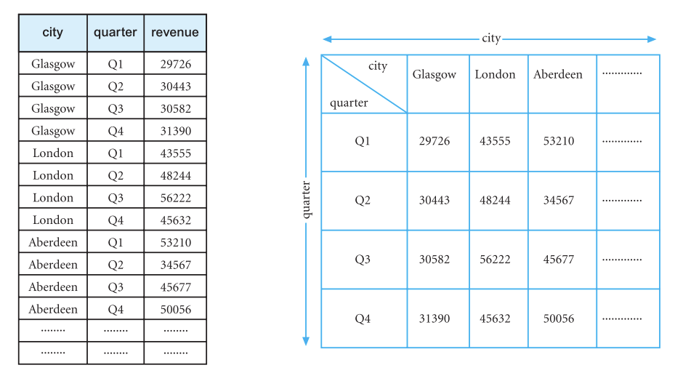
OLAP: Example relation (Connolly & Begg, 2015)
Typical OLAP query example
What is the total revenue generated by property sales in each city, in each quarter of 2004?
a) Output in relation
b) Output in cross-tabulation table

Slide 22
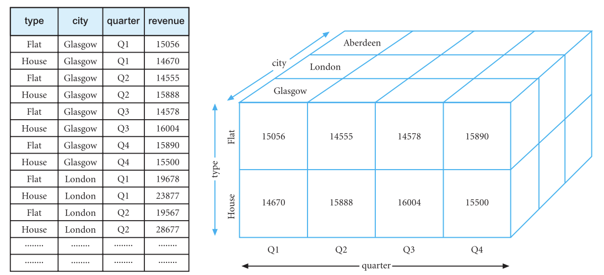
OLAP: Example relation ..cont’d (Connolly & Begg, 2015)
Typical OLAP query example
What is the total revenue generated by
property sales for each type of property (Flat or House) in each city, in each quarter of 2004?
a) Output in relation
b) Output in CUBE

Slide 23
GROUP BY: Without using OLAP
Typical OLAP query example (assume table: Sales*)
propertyType | yearMonth | city | salesAmt
flat | 2004-08 | Aberdeen | 115432
flat | 2004-08 | Edinburgh | 236573
flat | 2004-08 | Glasgow | 7664
flat | 2004-09 | Aberdeen | 123780
flat | 2004-09 | Edinburgh | 323100
flat | 2004-09 | Glasgow | 8755
house | 2004-08 | Aberdeen | 77987
house | 2004-08 | Edinburgh | 135670
house | 2004-08 | Glasgow | 4765
house | 2004-09 | Aberdeen | 76321
house | 2004-09 | Edinburgh | 166503
house | 2004-09 | Glasgow | 4889
What is the total revenue generated by
sales of each type of property (Flat or House), in August and September 2004?
SELECT propertyType, yearMonth, city, SUM (salesAmt) as sales
FROM Sales
WHERE yearMonth IN (‘2004-08’, ‘2004-09’) AND city IN (‘Aberdeen’, ‘Edinburgh’, ‘Glasgow’)
GROUP BY (propertyType, yearMonth, city)
Sales* examples in the book shows that the table is formed from three tables(Branch, PropertyForSale, PropertySale. For simplicity in our SQL queries, we assume a single relation ‘Sales’)
Connolly & Begg, 2015
Notes:
Sales* examples in the book shows that the table is formed from three tables(Branch, PropertyForSale, PropertySale. For simplicity in our SQL queries, we assume a single relation ‘Sales’)

Slide 24
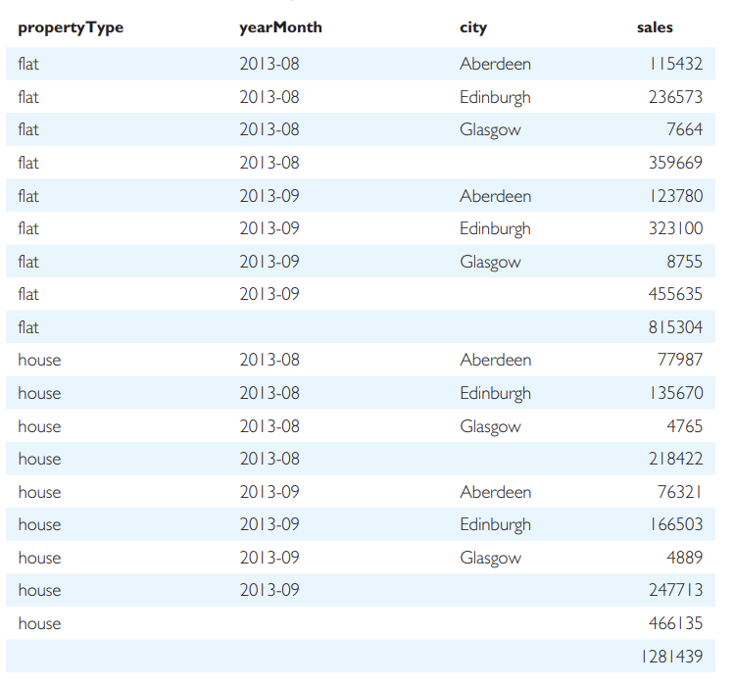
GROUP BY: using OLAP - ROLLUP
Typical OLAP query example (assume table: Sales)
What is the total revenue generated by
sales of each type in each city, in August and September 2004, along with the subtotals per month for each type, subtotals per type and grand total?
({type, yearMonth, city},{type, yearMonth}, {type},()):
Formula: n=3, groupings/levels of aggregation
= 3+1 = 4. Rollup generates 1 extra row for grant total
SELECT propertyType, yearMonth, city, SUM (salesAmt) as sales
FROM Sales
WHERE yearMonth IN (‘2004-08’, ‘2004-09’) AND city IN (‘Aberdeen’, ‘Edinburgh’, ‘Glasgow’)
GROUP BY ROLLUP (propertyType, yearMonth, city)
Connolly & Begg, 2015

Slide 25
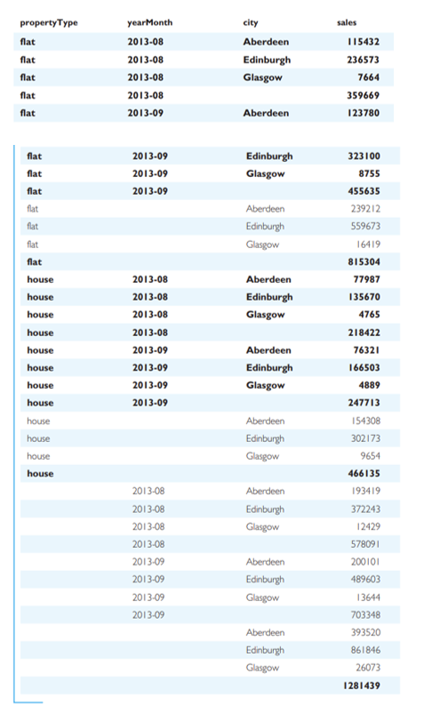
GROUP BY: using OLAP - CUBE
Typical OLAP query example (assume table: Sales)
What is the total revenue generated by
sales of each type in each city, in August and September 2004, along with all subtotals and grand totals?
Suppose: type=A;
yearMonth =B;
city =C.
See all groupings generated by CUBE: ({ABC},{AB},{AC},{A},{BC},{B},{C},())
Formula: CUBE (propertyType, yearMonth, city),
n=3, 2^3 = 8 groupings/levels of aggregation
SELECT propertyType, yearMonth, city, SUM (salesAmt) as sales
FROM Sales
WHERE yearMonth IN (‘2004-08’, ‘2004-09’) AND city IN (‘Aberdeen’, ‘Edinburgh’, ‘Glasgow’)
GROUP BY CUBE (propertyType, yearMonth, city)
From the table* rows in bold are similar with those generated in a ROLLUP function table
(Connolly & Begg, 2015)

Slide 26
Practice Activities
Part I: Advanced window functions
Ranking -- using employee salary dataset
Windowing – using covid dataset
7-day moving average
14-day moving average
30-day moving sum
Part II: OLAP queries on regional sales dataset Provided
Group by
Rollup
Cube
Please refer to the activity section for a detailed description of each part.

Slide 27
Assessment Activity 3: Test a variety of SQL queries
(also 3rd Project deliverable)
Test a variety of SQL queries of your choice on your database. Additional points will be awarded for queries derived from interesting use cases. Ensure that you test at least 15 different (including advanced window functions, and OLAP) queries and provide: 1) the query explanation/description, 2) the SQL statement/commands, and 3) the output/result for each query.

Slide 28
Summary
Advanced window functions
Ranking
Windowing
OLAP queries in SQL
Activities:
Practice: Part I (window functions) and Part II (OLAP queries)
Course Project: 3rd deliverable

Slide 29
References
Connolly, Thomas M, and Carolyn E Begg. Database Systems : A Practical Approach to Design, Implementation, and Management. 6th ed., Harlow, Essex, England, Pearson Education Limited, 2015.

